Slide 1
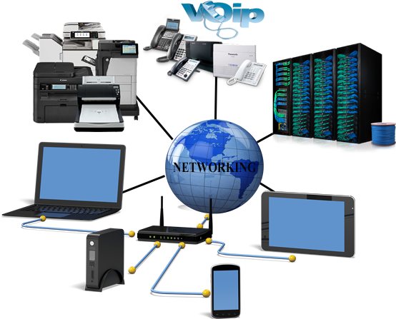
Computer Networks
What is a Computer Network
Why we need Computer Networks
OSI Model
TCP-IP Model

Slide 2



Slide 6


Computer A
Computer B

Slide 7
OSI MODEL (Open Systems Interconnection Model)
7 Application Layer
6 Presentation Layer
5 Session Layer
4 Transport Layer
3 Network Layer
2 Data Link Layer
1 Physical Layer
HTTP, HTTPS , FTP... | APDU
Encoding-Decoding, Compression, Encryption, SSL, TSL | PPDU
Create Maintain Renew Terminate Sessions | SPDU
UDP, TCP, Message Segmentation | Segments
Logical Addressing & Path Determination, IPv4, IPv6 | Packet
Access to Media MAC Address | Frames
Binary Transmission | Bits
Developed in the late 1970s
Seven layer model
Describers everything

Slide 8
OSI MODEL (Open Systems Interconnection Model)
7 Application Layer
6 Presentation Layer
5 Session Layer
4 Transport Layer
3 Network Layer
2 Data Link Layer
1 Physical Layer
Software Layer
Heart of OSI Model
Hardware Layer

Slide 9


OSI MODEL (Open Systems Interconnection Model)
DATA
7 Application Layer
6 Presentation Layer
5 Session Layer
4 Transport Layer
3 Network Layer
2 Data Link Layer
1 Physical Layer
7 Application Layer
6 Presentation Layer
5 Session Layer
4 Transport Layer
3 Network Layer
2 Data Link Layer
1 Physical Layer
DATA
Router

Slide 10
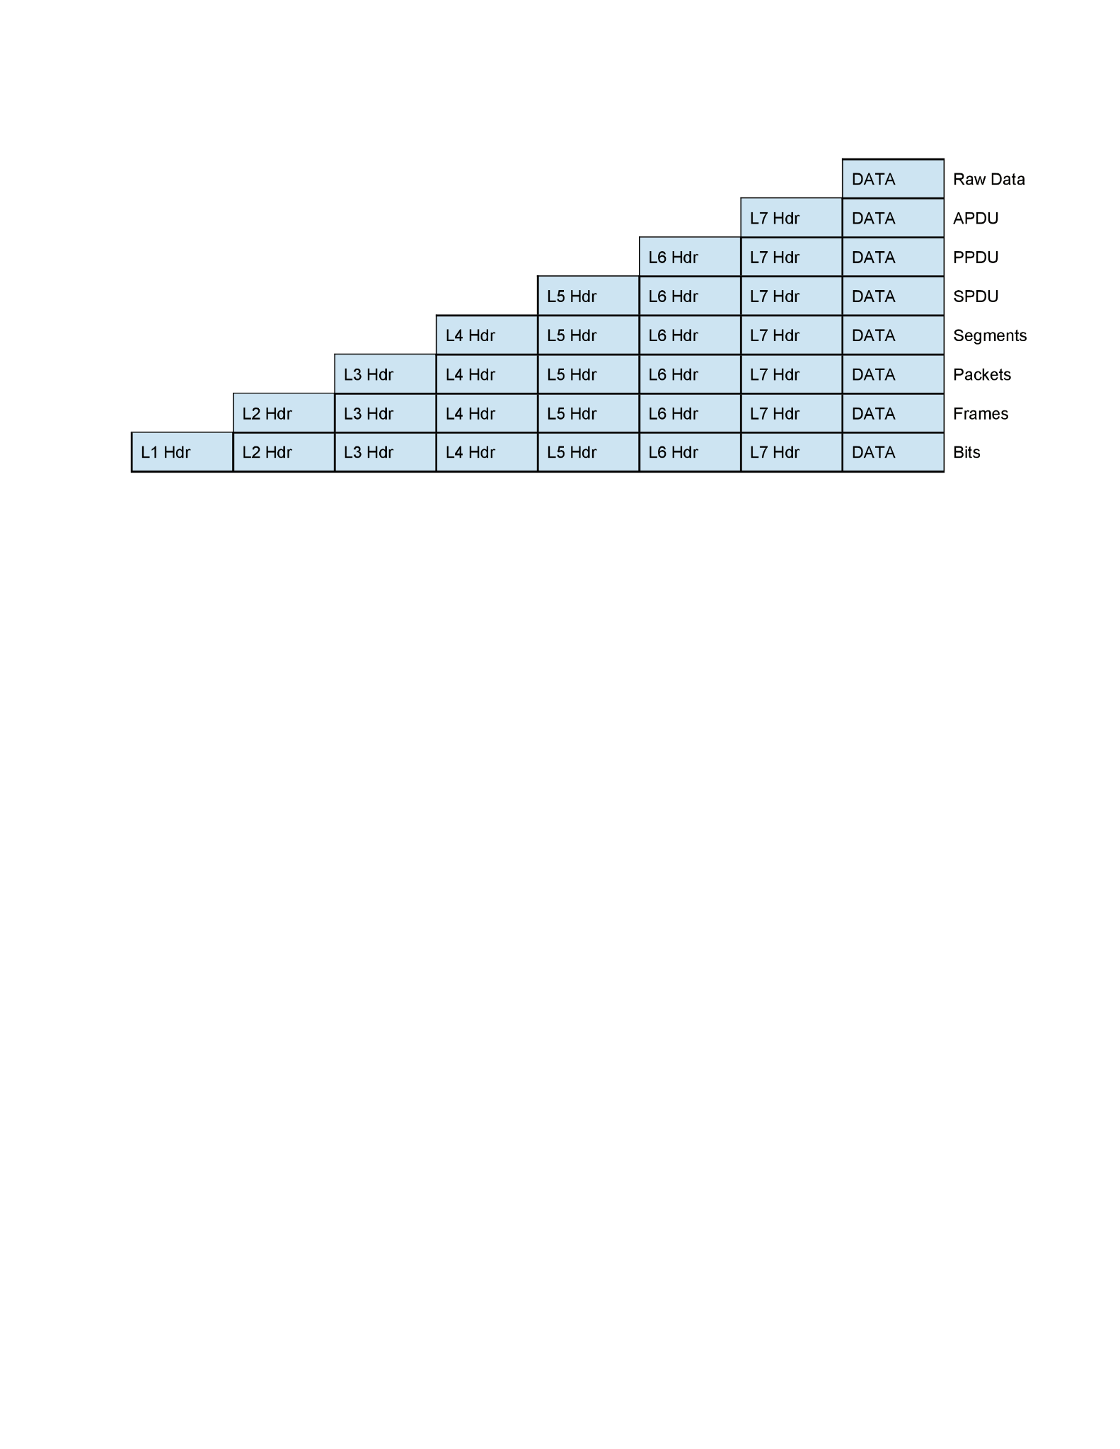
OSI MODEL (Open Systems Interconnection Model)
encapsulation
7 Application Layer
6 Presentation Layer
5 Session Layer
4 Transport Layer
3 Network Layer
2 Data Link Layer
1 Physical Layer
7 Application Layer
6 Presentation Layer
5 Session Layer
4 Transport Layer
3 Network Layer
2 Data Link Layer
1 Physical Layer
decapsulation

Slide 11
TCP-IP MODEL Transmission Control Protocol.
has 4 layers.
more reliable
developed by Department of Defense (DoD) in 1960s
Application Layer
Transport Layer
Internet Layer
Network Access Layer

Slide 12
Thanks
Created By Ajmal Nasumudeen

